Slide 1
Cryptocurrency Trend Analysis Group Project
Team Boa: Brandie Parker, Charlotte Coolidge, Jong Kim, Junki Ogawa
UPenn Data Science Bootcamp

Slide 2
Core message/Hypothesis
Virtual and cryptocurrency compared to tech (as it is: computers, specifically graphics cards), the USD, gas, and temperature prices
Questions we found interesting and what motivated us to answer them
Is crypto too volatile? Is it a good investment short/medium/long term?
How accessible is it for entry first time investors ?
Can we provide explanations on Bitcoin highs/lows?

Slide 3
Questions, and Where and how we found the data we used to answer these questions
Google Search Trend:
What happened in November 2017? What skyrocketed Google trend search of Bitcoin?
Peaked 18k in Dec 2017. Also had highest search
Did bitcoin trend go down before price in the “crypto crash of 2018”?
Compare with Bitcoin price - January 2017 to august 2021
Temp of the largest crypto/virtual currency mining farms
The number and volume of bitcoin mining
USD and top currencies vs Bitcoin
Gas price
Nvidia GPU price

Slide 4
The data exploration and cleanup process (accompanied by Jupyter Notebook)
After exploring the questions we wanted to ask of our data, we obtained our datasets from Kaggle
Cleaning process
We scrubbed the data after importing it, in order to drop NaN values, etc. for all of our data comparisons

Slide 5
Analysis process (accompanied by Jupyter Notebook)
After pulling and cleaning, we merged our datasets, in order to better analyze, plot, compare, and summarize the information from our analyses

Slide 6
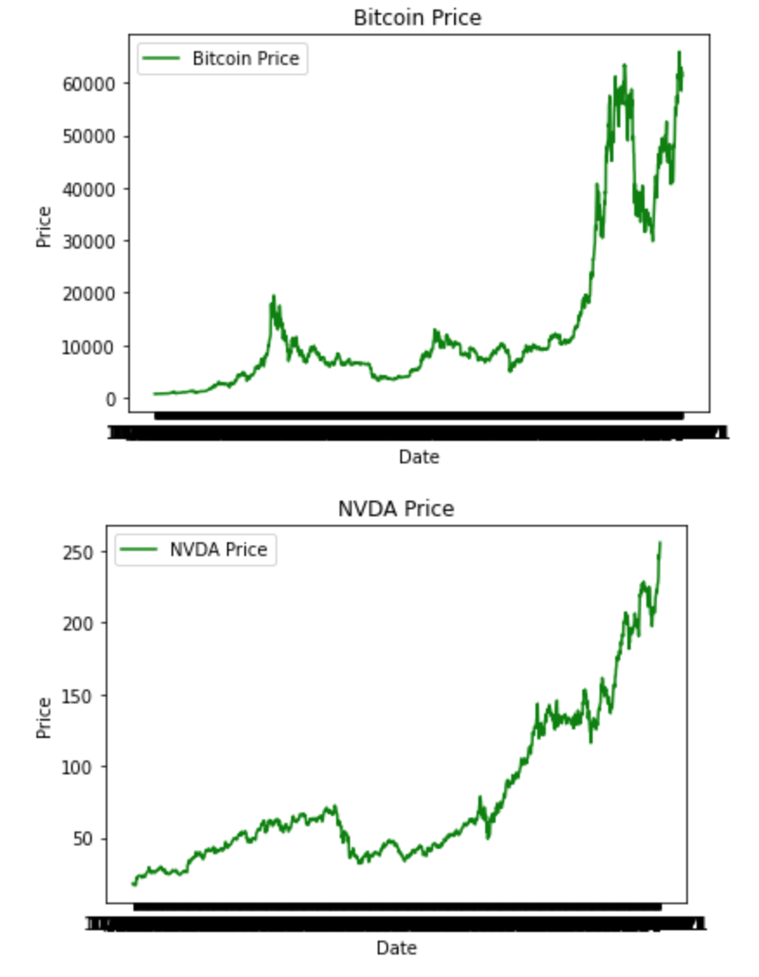
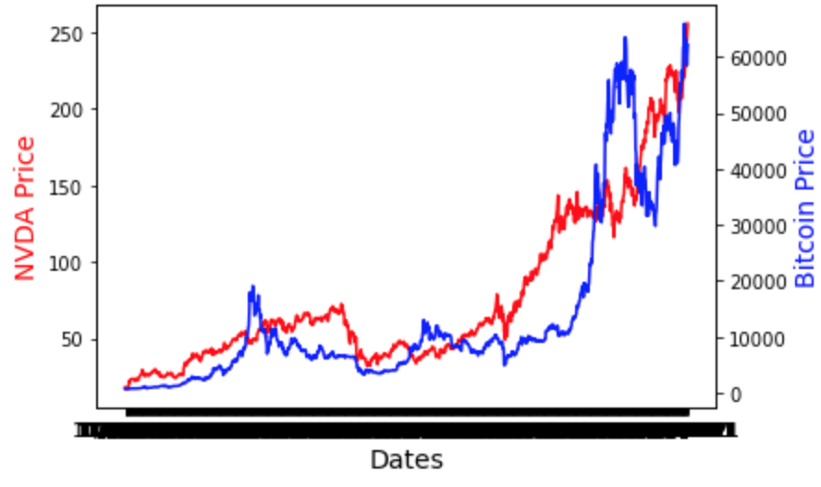
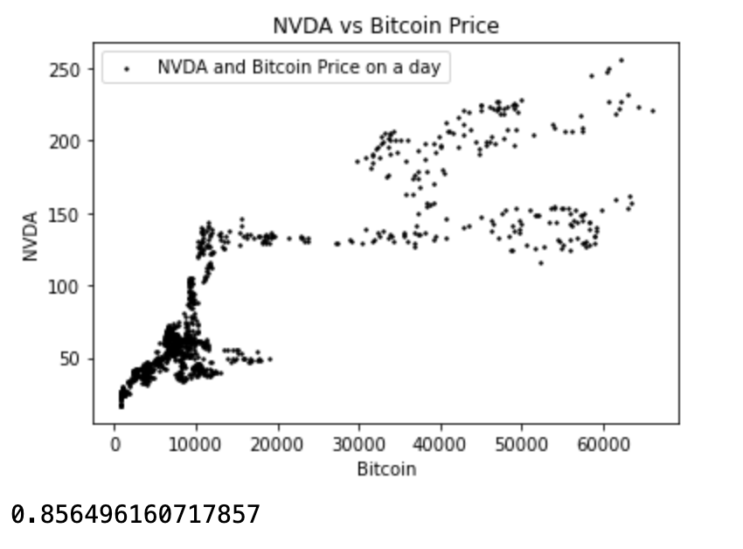
Conclusions including a numerical summary and visualizations of the summary: NVIDIA GPUs
NVIDIA Stock Compared to Bitcoin Price:
Strong positive correlation

Slide 7
Conclusions including a numerical summary and visualizations of the summary: Data Centers
These countries, and regional areas are being incentivized from an economic perspective to house and run these massive data mining centers (as with the case in Iceland, this business represents 1% of their GDP), but it’s to the detriment of their own microclimates. As, these data centers now account for more electricity use than all of Iceland’s homes combined.
According to local experts cited by The Wall Street Journal, keeping up with demand for electricity requires building more dams and power stations that could alter Iceland’s unique, sensitive environment.

Slide 8
Conclusions including a numerical summary and visualizations of the summary: Gas Prices

Slide 9
The implications of our findings: What do our findings mean?
Hydroelectric energy off-put required to maintain and run these mass crypto mining warehouses is greatly affecting how much energy is therefore needed to heatsink their output
Affect on surrounding temperatures?
NVIDIA Stock Compared to Bitcoin Price:
Strong positive correlation between the NVIDIA stock and Bitcoin cryptocurrency price over time
Gas Compared to Bitcoin Price:
Moderately positive correlation between the NVIDIA stock and Bitcoin cryptocurrency price over time

Slide 10
Resources
Weather Data https://www.worldweatheronline.com/
The Top 5 Largest Mining Operations in the World https://thebitcoinnews.com/the-top-5-largest-mining-operations-in-the-world/
Kaggle - https://www.kaggle.com/
https://www.kaggle.com/odins0n/top-50-cryptocurrency-historical-prices
https://www.kaggle.com/kaushiksuresh147/bitcoin-tweets

